Slide 1


托福听力6
金牌听力名师
大菁儿老师
2021.6.11

Slide 2
第五节课回顾： 十大考点——例子+强调； 自然科学词汇串讲 天文学+地理学文章及菁讲精练

Slide 3
十大考点——对比+分类；
生命科学词汇串讲
生态学+动物学菁讲精练

Slide 4
考点五：记对比
老师说：we should not confuse A and B.
我们不能混淆A和B
Let’s make a clear distinction between A and B:
笔记迅速横着排开，有细节——出题点
提示词：
compare…to, contrast, unlike, similar to, in comparison with/to, in contrast to, differently, differ, alike, resemble, on the other hand, on the contrary, instead, likewise, in the same way…

Slide 5
对比题练习1
TPO17-L4 octopus 26'-1'16
proteus
mythology
transformation
texture
version
fascinating

Slide 6

练习
TPO17-L4 octopus 笔记
proteus? god in G 改型： lion+stone+tree
quick
oct: real
3: color;texture;size&shape

Slide 7
TPO14-1 octopus
2.Why does the professor first mention Proteus?
A. To explain how the octopus got its scientific name
B. To introduce the octopus' exceptional abilities
C. To point out that the octopus played an important role in Greek mythology
D. To provide an example of a mythological character that was part animal and part human

Slide 8
考点六 ：记分类
讲座开始可能教授会说，
EG: There are many types of vocalizations… We’ve characterized their vocalizations into three types:
whistles, cliques and burst pulses.
赶紧把这三种声音横着排开，一定会考细节的。
表格题！
另外还有一种情况，老师不说具体的数，说很多。例如，我们有很多收集数据的方法，描述数据，实验，观察
EG: We gather data in a variety of ways: descriptive, experimental an observational.

Slide 9
分类练习1
TPO40-L4 1'18-1'54' 2'18-2'31
tremendous
infrastructure
asset
lease
toll
tunnel
repair
government entity

Slide 10
Well, that’s not so simple. Government officials are elected by voters, and voters get upset when their taxes go up. And, as for highway tolls, commuters, especially, don’t like paying higher tolls. Merely proposing increases can damage political careers.
So there’s tremendous pressure on governments to find other ways to maintain infrastructure assets. One solution is to sell or lease a part of the infrastructure—a toll bridge, a tunnel, something like that—to a private company, usually a company that specializes in this sorta thing.
But besides that, there’s another reason governments like these deals. States often have trouble paying their bills, and they can use money they get from selling or leasing a piece of infrastructure to balance their budgets.

Slide 11
3.According to the professor, why do governments consider selling or leasing pieces of infrastructure? [Click on 2 answers.]
A. Governments often have difficulty balancing their general budgets.
B. The money that governments receive from user fees has gone down in recent years.
C. Political considerations limit governments' ability to raise money for maintenance.
D. Private companies are better able to estimate the cost of infrastructure repairs.

Slide 12
动物学场景词汇
blowhole ['blohol] n.(鲸、海豚等的)喷水孔
bursa [ˈbɜːsə] n.(尤指关节处的)滑囊
cavity [ˈkævɪtɪ] n.洞; 腔
melon [ˈmɛlən] n.(鲸目动物头部的)圆形隆起
nasal ['nezl] adj.鼻的；鼻音的
trunk [trʌŋk] n.象鼻；树干
pouch [paʊtʃ] n.囊状部
projection [ prə'dʒekʃ(ə)n] n.突出物；突起
rear [rɪə] n.后面，后部
sac [sæk] n.囊
skull [skʌl] n.头骨
skeletal ['skɛlətl] adj.骨骼的
skeleton ['skɛlɪtn] n.骨架，骨骼
tissue [ˈtɪʃu:] n.（身体）组织；薄纸巾
venom ['vɛnəm] n.(某些蛇、蝎子等分泌的)毒液

Slide 13
动物学场景词汇
circulatory system ['sɝkjələtɔri] ['sɪstəm] [解剖] 循环系统
feather ['fɛðɚ] n.羽毛
fur [fɝ] n.毛皮
liver ['lɪvɚ] n.肝脏
lung [lʌŋ] n.肺；呼吸器
organ ['ɔrɡən] n.器官；机构；风琴；管风琴
cell [sɛl] n.细胞
cellular ['sɛljəlɚ] adj.细胞的，多孔的
cellulose ['sɛljulos] n.纤维素；细胞膜质
embryo ['ɛmbrɪo] n.胚胎
anatomy [ə'nætəmi] n.解剖；解剖学
eardrum ['ɪrdrʌm] n.耳膜；鼓膜
muscle ['mʌsl] n.肌肉
membrane ['mɛmbren] n.膜
vessel ['vɛsl] n.血管
gland [glænd] n.腺
tentacle ['tɛntəkl] n.触手；触角；触须
jaw [dʒɔ] n.颌；下巴
limb [lɪm] n.肢，臂

Slide 14
动物学场景词汇
torso ['tɔrso] n.躯干
tendon ['tɛndən] n.腱
beak [biːk] n.(猛禽, 甲鱼等的)嘴,鸟嘴状物体
chromatophore ['kromətə,fɔr] n.色素体
rhizome ['raɪzom] n.根茎；[植] 地下茎
streak [strik] n.（与周围有所不同的）条纹
stem [stɛm] n.干；茎
nectar ['nɛktɚ] n.[植] 花蜜
pollen ['pɑlən] n.[植] 花粉
filament ['fɪləmənt] n.[植](雄蕊的)花丝；丝状体；藻丝；菌丝
bulb [bʌlb] n.(洋葱、百合等的)球茎，球根
petal ['pɛtl] n.花瓣
bud [bʌd] n.蓓蕾，花骨朵；幼芽
shoot [ʃut] n.抽枝，发芽
crown [kraʊn] n.树冠，树顶
canopy ['kænəpi] n.树冠；伞盖
branch [bræntʃ] n.树枝
twig [twɪɡ] n.嫩枝，末梢

Slide 15
动物学场景词汇
carnivore ['kɑrnɪvɔr] n.肉食动物
omnivore ['ɑmnɪvɔr] n.杂食动物
herbivore [ˈhə:bəˌvɔr] n.食草动物
scavenger ['skævɪndʒɚ] n.食腐动物
invertebrate [ɪn'vɝtɪbret] n.无脊椎动物
vertebrate [ˈvə:təbrɪt] n.脊椎动物
primate [ˈpraimit] n.灵长类动物
mammal [ˈmæməl] n.哺乳动物
mega fauna ['mɛgə] [fɔ:nə] 大型动物
colubrid ['kɒljʊbrɪd] n.无毒蛇类 adj.无毒蛇的
aquatic [ə'kwætɪk] adj.水生的
reptile ['rɛptaɪl] n.爬行动物, 爬虫
amphibian [æm'fɪbɪən] n.两栖动物
rodent ['rodnt] n.啮齿动物
herd [hɚd] n.兽群，牧群
flock [flɑ:k] n.兽群；鸟群
swarm [swɔrm] n.蜂群
flora [ˈflɔ:rə] n.植物群
fauna [ˈfɔ:nə] n.动物群
insect ['ɪnsekt] n.昆虫
pest [pɛst] n.害虫

Slide 16
动物学精讲精练：
TPO20-lecture4 snowshoe
Maine
camouflage
furry
hind feet
adaptation

Slide 17
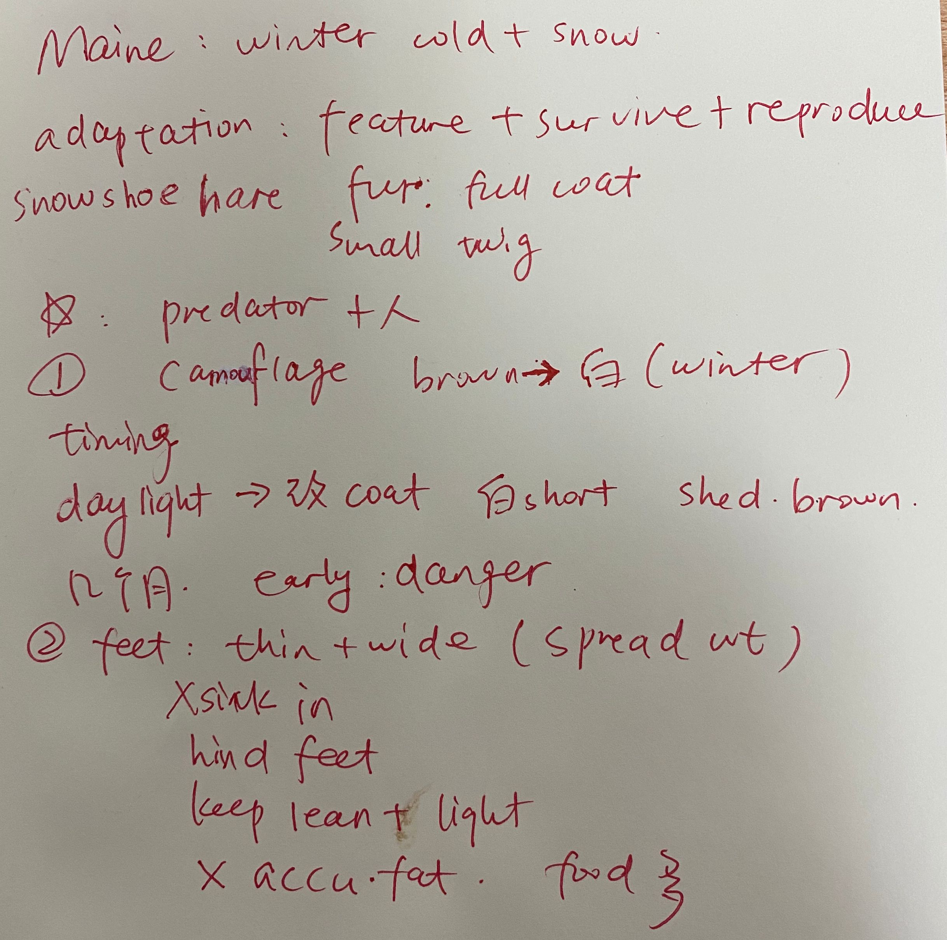
TPO20-lecture4
笔记

Slide 18
TPO20-lecture4
What is the lecture mainly about?
A. Typical features of the snowshoe hare that do not result from adaptation
B. Various strategies used by snowshoe hares to find food during the winter
C. Characteristics that snowshoe hares have developed in response to their environment
D. Interactions between snowshoe hares and human populations in the state of Maine

Slide 19
TPO20-lecture4
According to the professor, what causes the snowshoe hare’s fur to begin turning white?
A. A decrease in the hours that the Sun is up each day
B. A sudden drop in temperature
C. The increasing amount of snow on the ground
D. The changing nature of the food supply

Slide 20
TPO20-lecture4
Why might an early snowfall be a particularly dangerous time for the snowshoe hare?
A. Its feet would not yet have grown to resemble snowshoes.
B. Its babies would not yet be able to keep themselves warm.
C. Its chances of being seen by a predator are much higher.
D. It might not be able to locate where it stored its food supply.

Slide 21
TPO20-lecture4
The professor implies that the snowshoe hare has an advantage over other animals because of its unusual feet. What is that advantage?
It can reach food in higher locations better than its competitors.
It can stay warm in cold weather longer than its competitors.
It can outrun its predators in deep snow.
It can dig under the snow to hide from its predators.

Slide 22
TPO20-lecture4
The professor explains that the snowshoe hare’s food supply is available year-round. What does the availability of food allow the snowshoe hare to do?
A. Store body fat for the cold months
B. Remain lightweight through the winter
C. Give birth during the winter
D. Grow fur quickly during the first year after birth

Slide 23
TPO20-lecture4
Why does the student say this:
A. He wants to support the professor’s point with an example.
B. He is grateful the professor has answered his question.
C. The professor’s explanation contradicts his own experience.
D. The professor may not believe he is telling the truth.

Slide 24
生物学词汇 biology
biological community - 生物群落
organism ['ɔ:ɡənizəm] n.有机体；生物体；微生物
species [ˈspi:ʃi:z] n.物种；种类
genus ['dʒinəs] n.类，种；[生物] 属
microscopic [,maɪkrə'skɑpɪk] adj.微观的；用显微镜可见的
microscopic plant [ˌmaɪkrəˈskɔpɪk plɑ:nt] 微生植物
microbe ['maɪkrob] n.细菌，微生物
microorganism [ˌmaɪkrəʊˈɔːɡəˌnɪzəm] n.微生物
bacteria [bæk'tɪrɪə] n.细菌
108
extremophile [ik'stri:məfail] n. (能在极端恶劣环境下生存良好的)极端微
生物
fungus (pl. fungi) ['fʌŋɡəs] n.真菌；菌类
diversity [dɪˈvəsɪti] n.多样性
biodiversity [ˌbaɪəʊdaɪˈvɜ:səti] n.生物多样性
pedodiversity [pedədaɪˈvɜ:səti] n.土壤多样性
diversification [daɪˌvɜ:sɪfɪ'keʃn] n.变化，多样化
niche [nɪtʃ] n.壁龛；生态龛

Slide 25
生物学词汇 biology
medium [ˈmiːdɪəm] n.媒介物
devastate ['devəstet] v.破坏，毁灭
distribute [dɪˈstrɪbju:t] v.分配，散布
dwindle [ˈdwɪndl] vi.减少，变小，缩小；
outbreak [ˈaʊtbrek] n.（战争，怒气等）爆发；突然发生
perish ['pɛrɪʃ] vi.死亡；毁灭
extinction [ɪk'stɪŋkʃən] n.灭绝
fertilizer ['fɝtəlaɪzɚ] n.肥料
fertile ['fɝtl] adj.富饶的，肥沃的；能生育的
decay [dɪ'ke] v.腐烂
decomposition [ˌdi:kɒmpə'zɪʃn] n.分解；腐烂
rot [rɒt] n 腐烂，腐朽
excrete [ɪk'skrit] vt.排泄；分泌
thrive [θraɪv] vi.繁荣，兴旺
photosynthesis [ˌfəutəuˈsinθəsis] n.光合作用
photoreceptor ['fotorɪsɛptɚ] n.感光器
respiration [,rɛspə'reʃən] n.呼吸；呼吸作用
adsorption [æd'sɔrpʃən] n.吸附（作用）
osmosis [ɒz'məʊsɪs] n. [物] 渗透；[物] 渗透性；渗透作用
osmotic [ɑs'motɪk] adj.渗透性的，渗透的

Slide 26
生物学词汇 biology
resilient [rɪ'zɪlɪənt] adj.弹回的，有弹力的
resistant [rɪ'zɪstənt] adj.抵抗的; 反抗的; 耐久的; 坚固的, 稳定
的, 抗性的
relic [ˈrɛlɪk] n.遗物，遗迹
explode [ɪk'splod] v.爆发；激增
conservation [,kɑnsɚ'veʃən] n.保存，保持；保护
overhunt ['ovɚ 'hʌnt] v.过度捕猎
mineralize ['mɪnrəl,aɪz] v.使矿物化
migration route [maɪ'ɡreʃən] [rut] 迁移路线
threatened species ['θrɛtnd] ['spiʃiz] 濒危物种
interdependent species [,ɪntɚdɪ'pɛndənt] - 相互依存的物种
symbiosis [,sɪmbaɪ'osɪs] n.共生关系
invasive species [ɪn'vesɪv] - 入侵物种
habitat ['hæbɪtæt] n.栖息地
meadow ['mɛdo] n.草甸, 草地, 牧场

Slide 27
练习：
TPO15-lecture4 生物群落的新发现
photosynthesis
bacteria
microorganism
hydrothermal
chemosynthetic 化能合成的
vessel
carbon dioxide
hydrogen sulfide
digestive
tube worm
chemosynthesis
chemical reaction

Slide 28
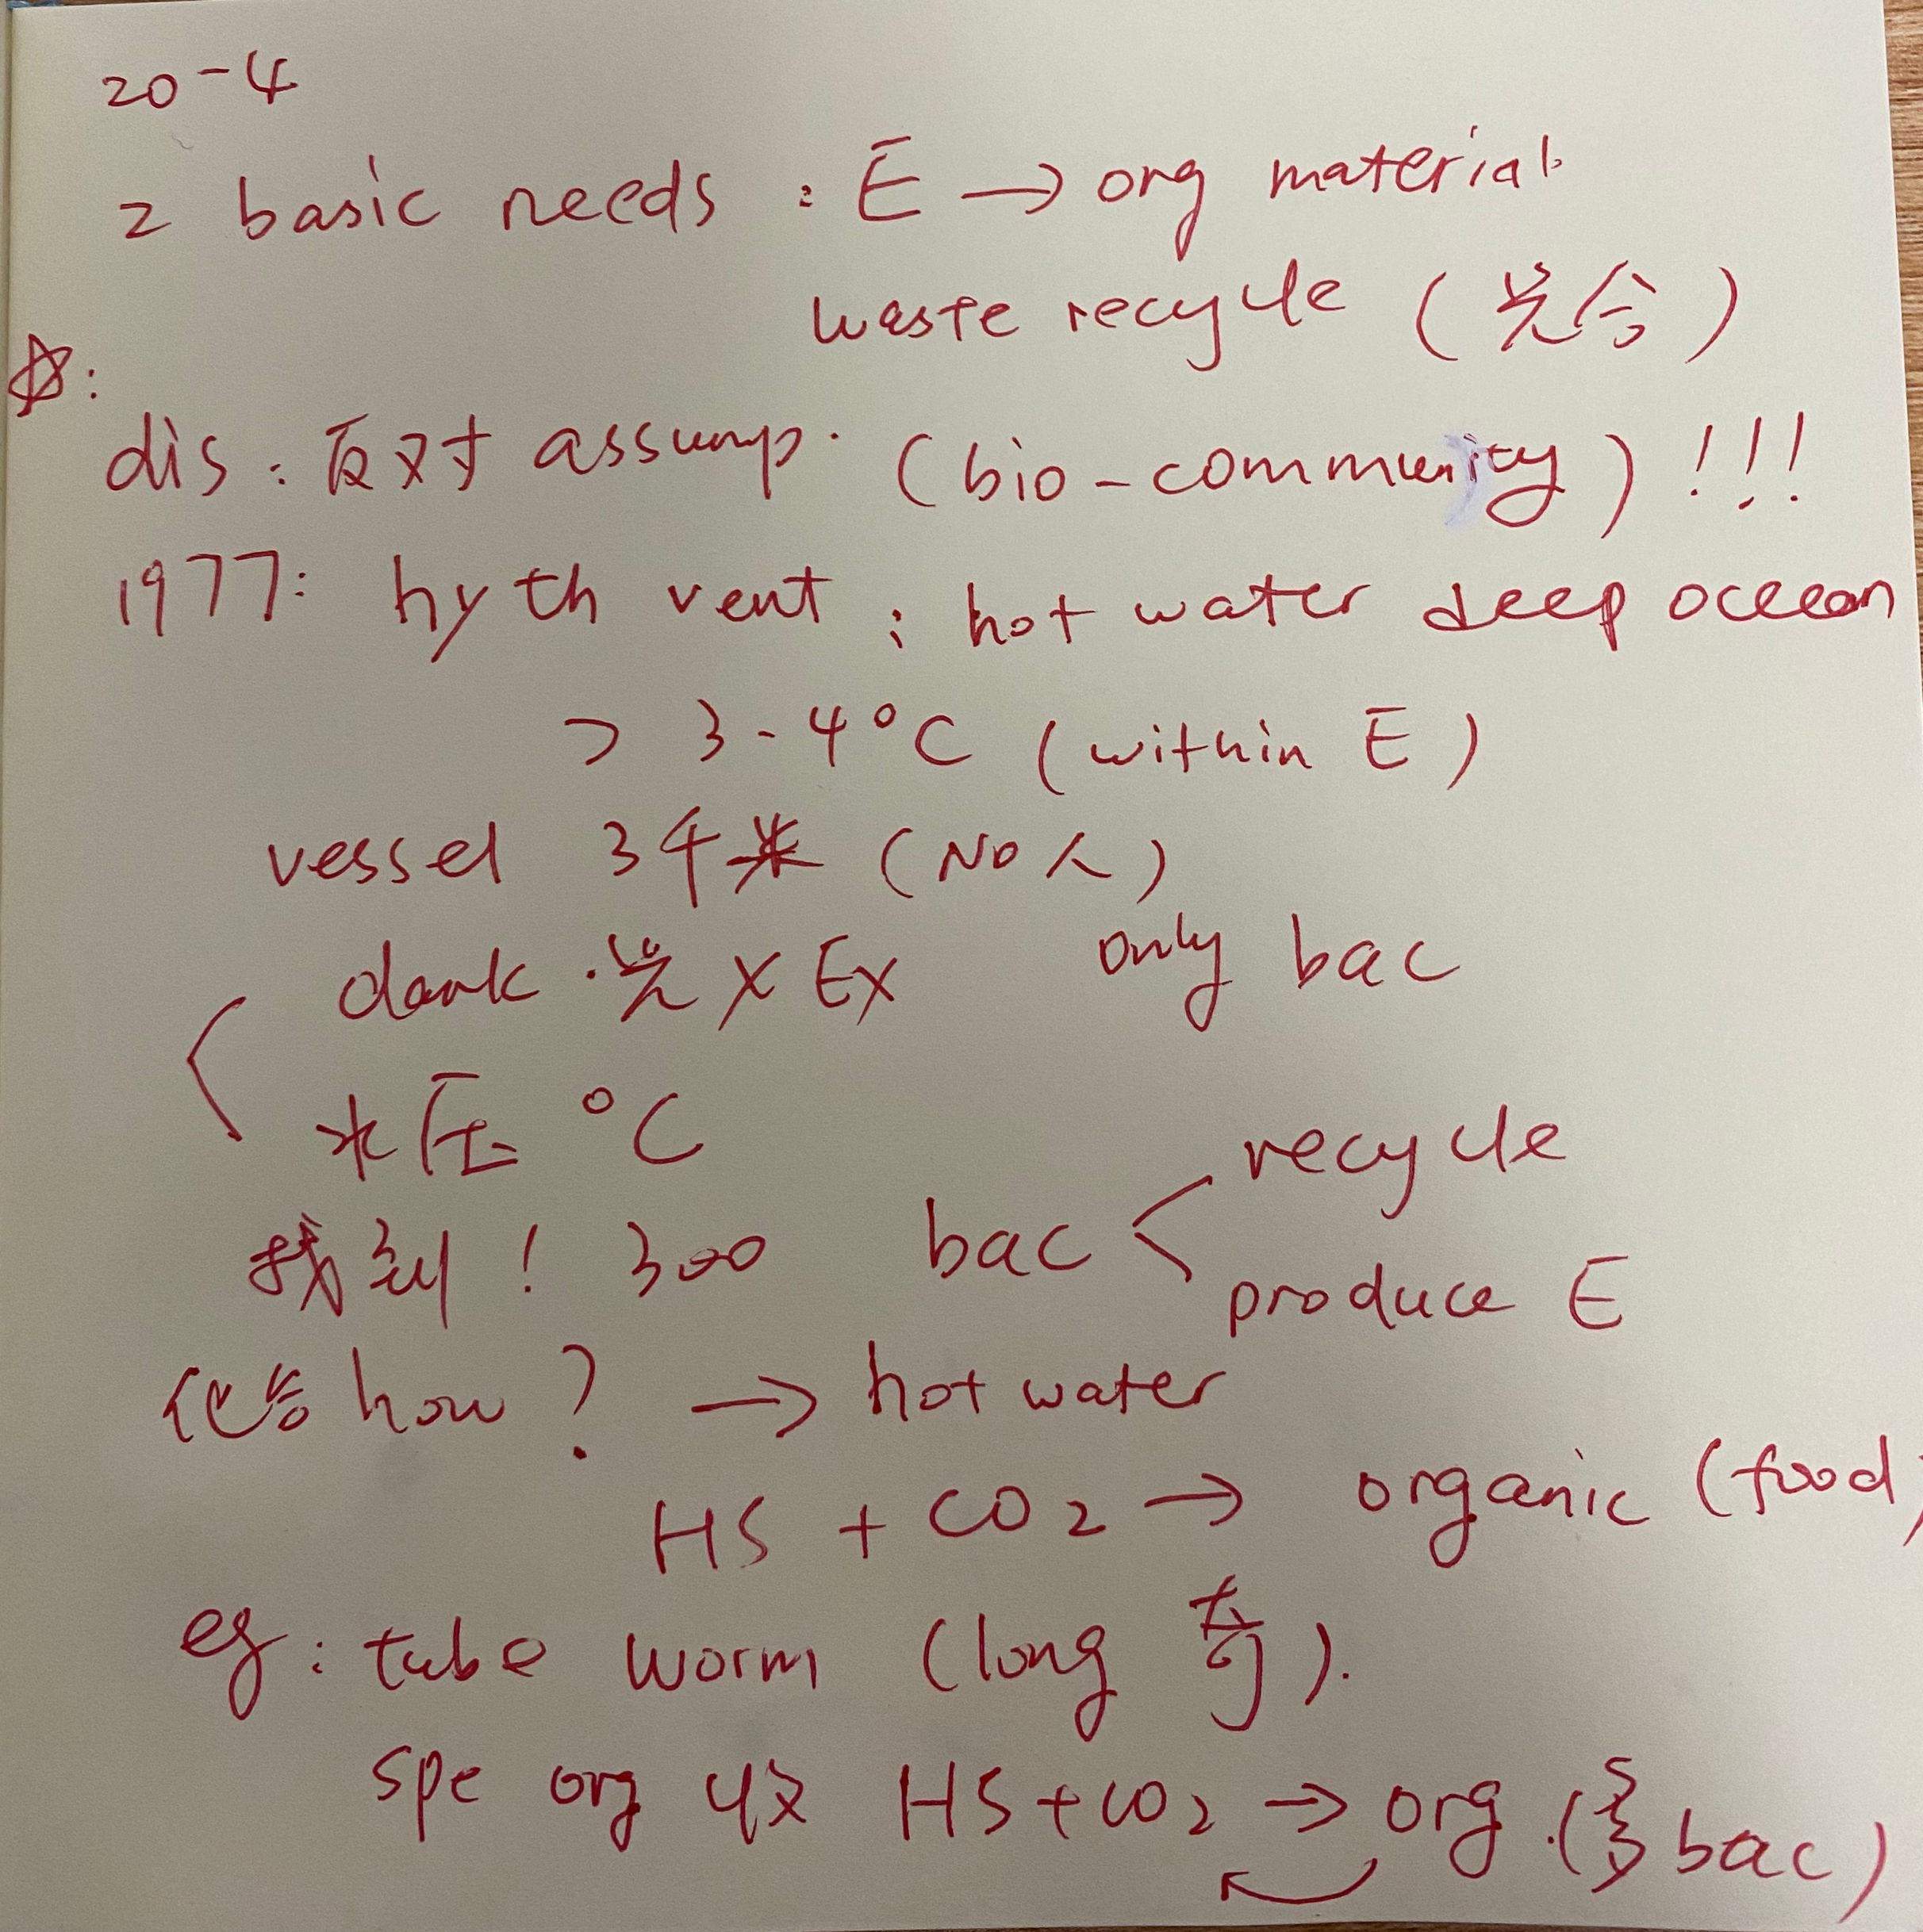
TPO15-lecture4
笔记

Slide 29
TPO15-lecture 4
Why does the professor discuss the exploration of hydrothermal vents?
A. To show how the exploration helped researchers to determine the composition of ocean water.
B. To show how the exploration challenged an assumption about biological communities.
C. To compare two competing theories concerning chemosynthesis.
D. To compare the life cycle of underwater plants to the life cycle of underwater animals.

Slide 30
TPO15-lecture 4
What does the professor imply about the researchers’ reaction to the biological community discovered on the ocean floor?
A. They were surprised at the large variety of organisms living near hydrothermal vents.
B. They were surprised to find any bacteria living without sunlight.
C. They were disappointed at not finding any animal life.
D. They could not agree on the significance of the data that they collected.

Slide 31
TPO15-lecture 4
According to the professor, what is the role of chemosynthesis in biological communities that are found hydrothermal vents?
A. It enables organisms to convert hydrogen sulfide into food.
B. It enables organisms to convert tiny amounts of light into energy.
C. It enables organisms to withstand large amounts of carbon dioxide.
D. It enables organisms to regulate their temperature.

Slide 32
TPO15-lecture 4
Why does the professor mention the bacteria that live inside a tube worm?
A. To give an example of organisms that pose a threat to tube worms.
B. To explain what provides the organic material that tube worms use for energy.
C. To give an example of other organisms that can withstand extreme heat.
D. To give an example of organisms that are involved in both chemosynthesis and photosynthesis.

Slide 33
TPO15-lecture 4
What does the professor imply when she says this
A. She will review information from the assigned chapter.
B. She will present additional information related to the assigned chapter.
C. The quiz on the assigned chapter will be longer than other quizzes.
D. The class has spent too much time on the assigned chapter.rature.

Slide 34
课后作业：
1. 回顾本次课内容，完成生态学+动物学单词记忆内容
2. 完成TPO13-2；10-2；29-1；
49-3；46-1；27-3的所有lecture题目
3. 预习第七次课中植物学+环境科学词汇
题目群里打卡

Slide 35

【✨课程福利✨】
1. 微博打卡：#考虫托福系统班#+天数+收获+图片+@考虫托福 @相应科目的老师 @酵母菁
（1）每周一抽取2个上周连续打卡的虫子送抱枕
2. 听课评论，听课后点击右上角【评论】按钮，说说虫子们对课程的想法和感受，课程结束后抽2个考虫T恤喔！

Slide 36
练习：
TPO50-lecture1
trade and commerce
Bronze Age
archeological excavation
production stage
transparent mineral
vessels
jar
clay
metallic dye
Mesopotamia
precious stones
emeralds and pearls
bead
sophisticated process
perfume
royal family
mutual trade
disk

Slide 37
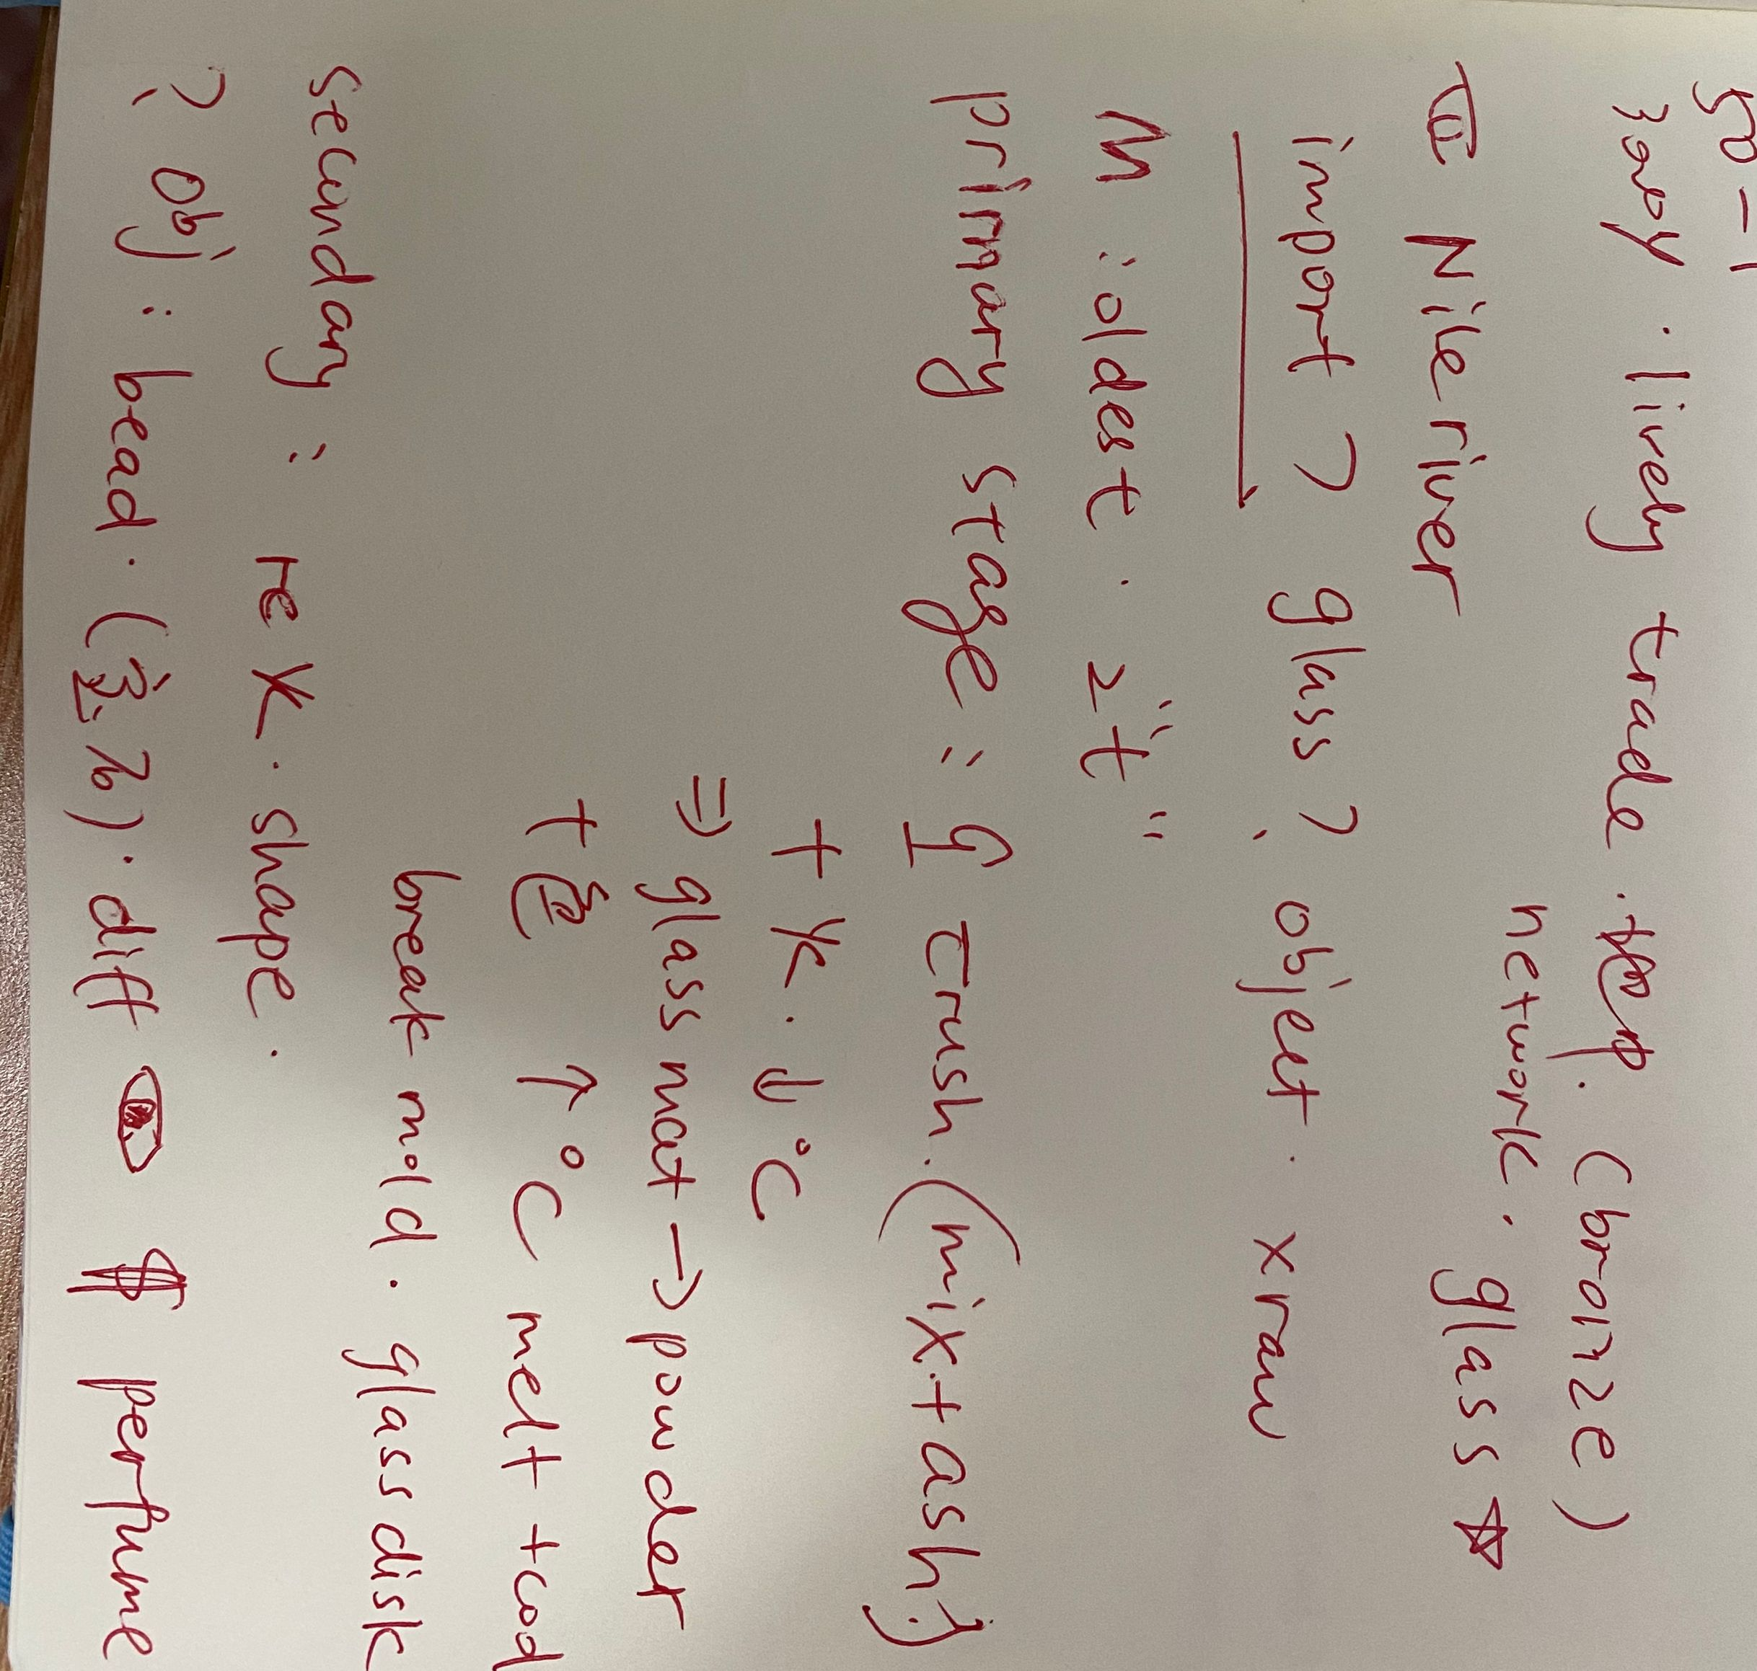
TPO50-lecture1
笔记

Slide 38
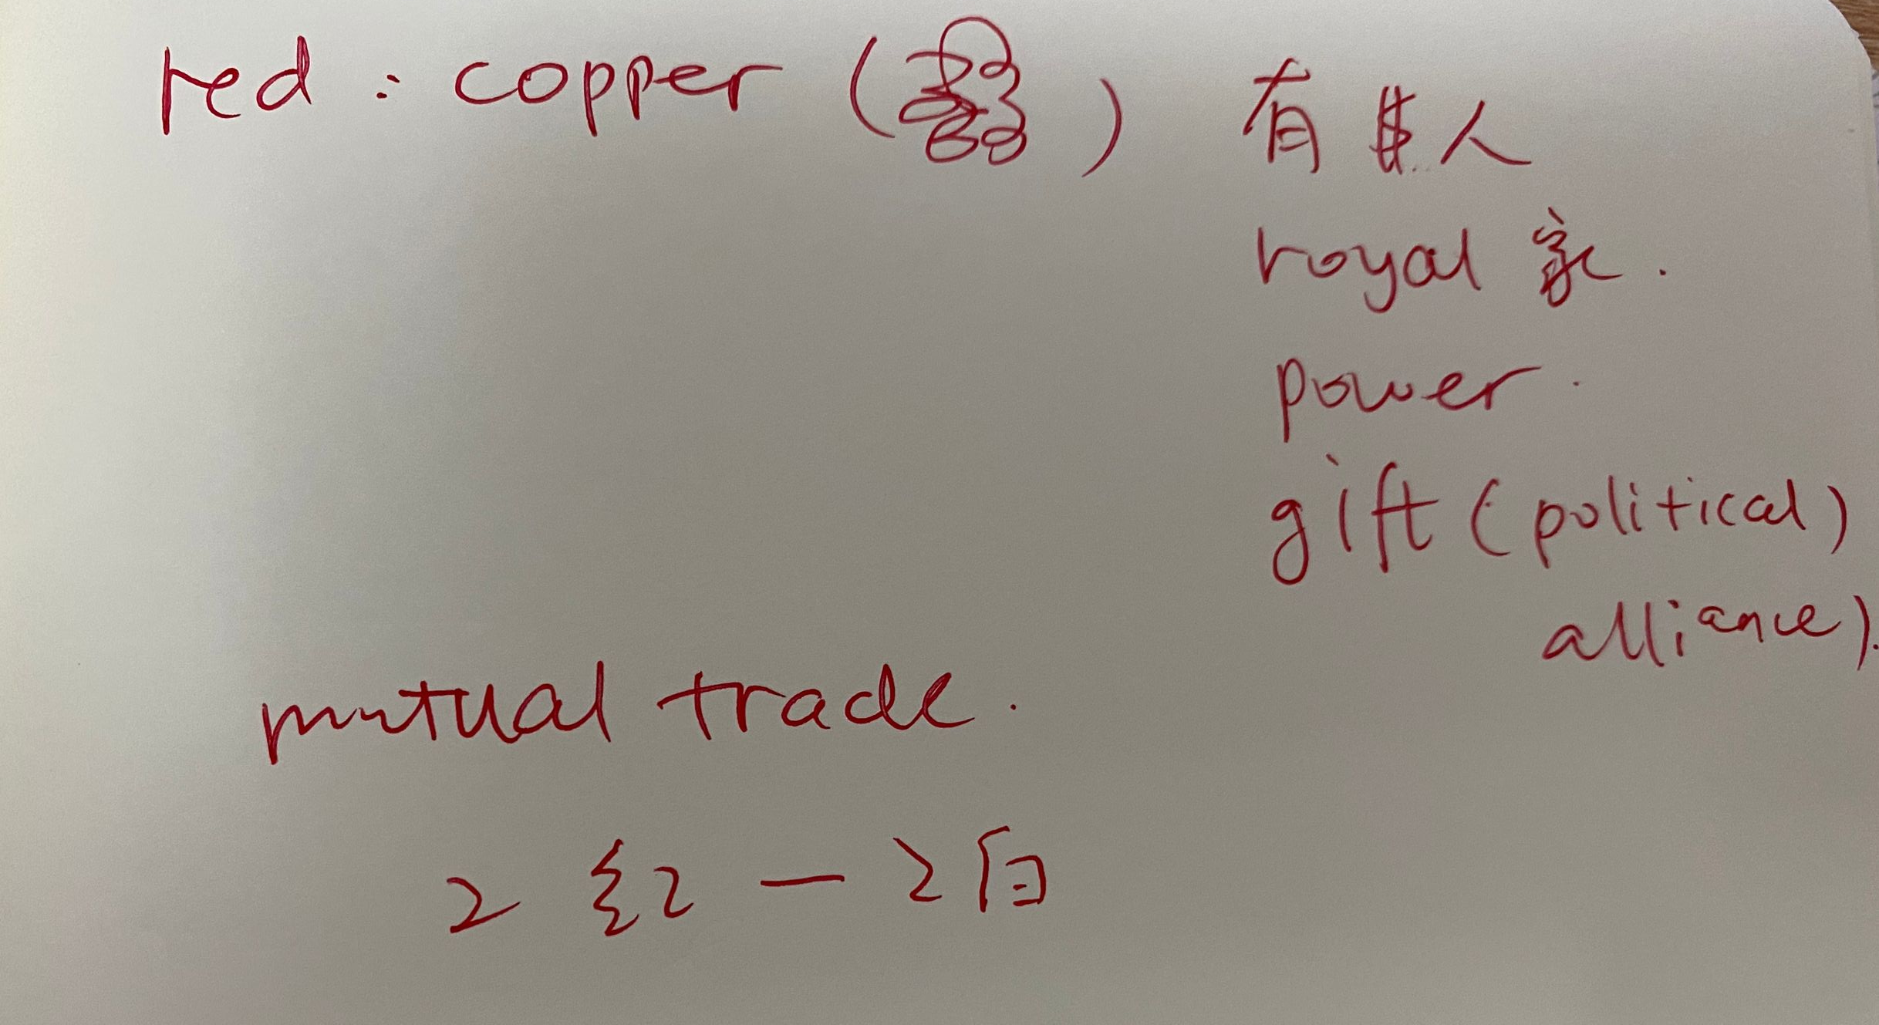
TPO50-lecture1

Slide 39
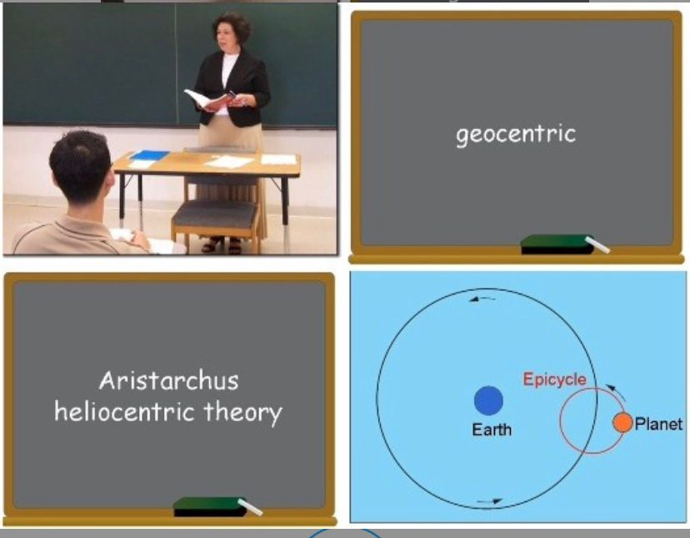
综合练习：
TPO21-L1

Slide 40
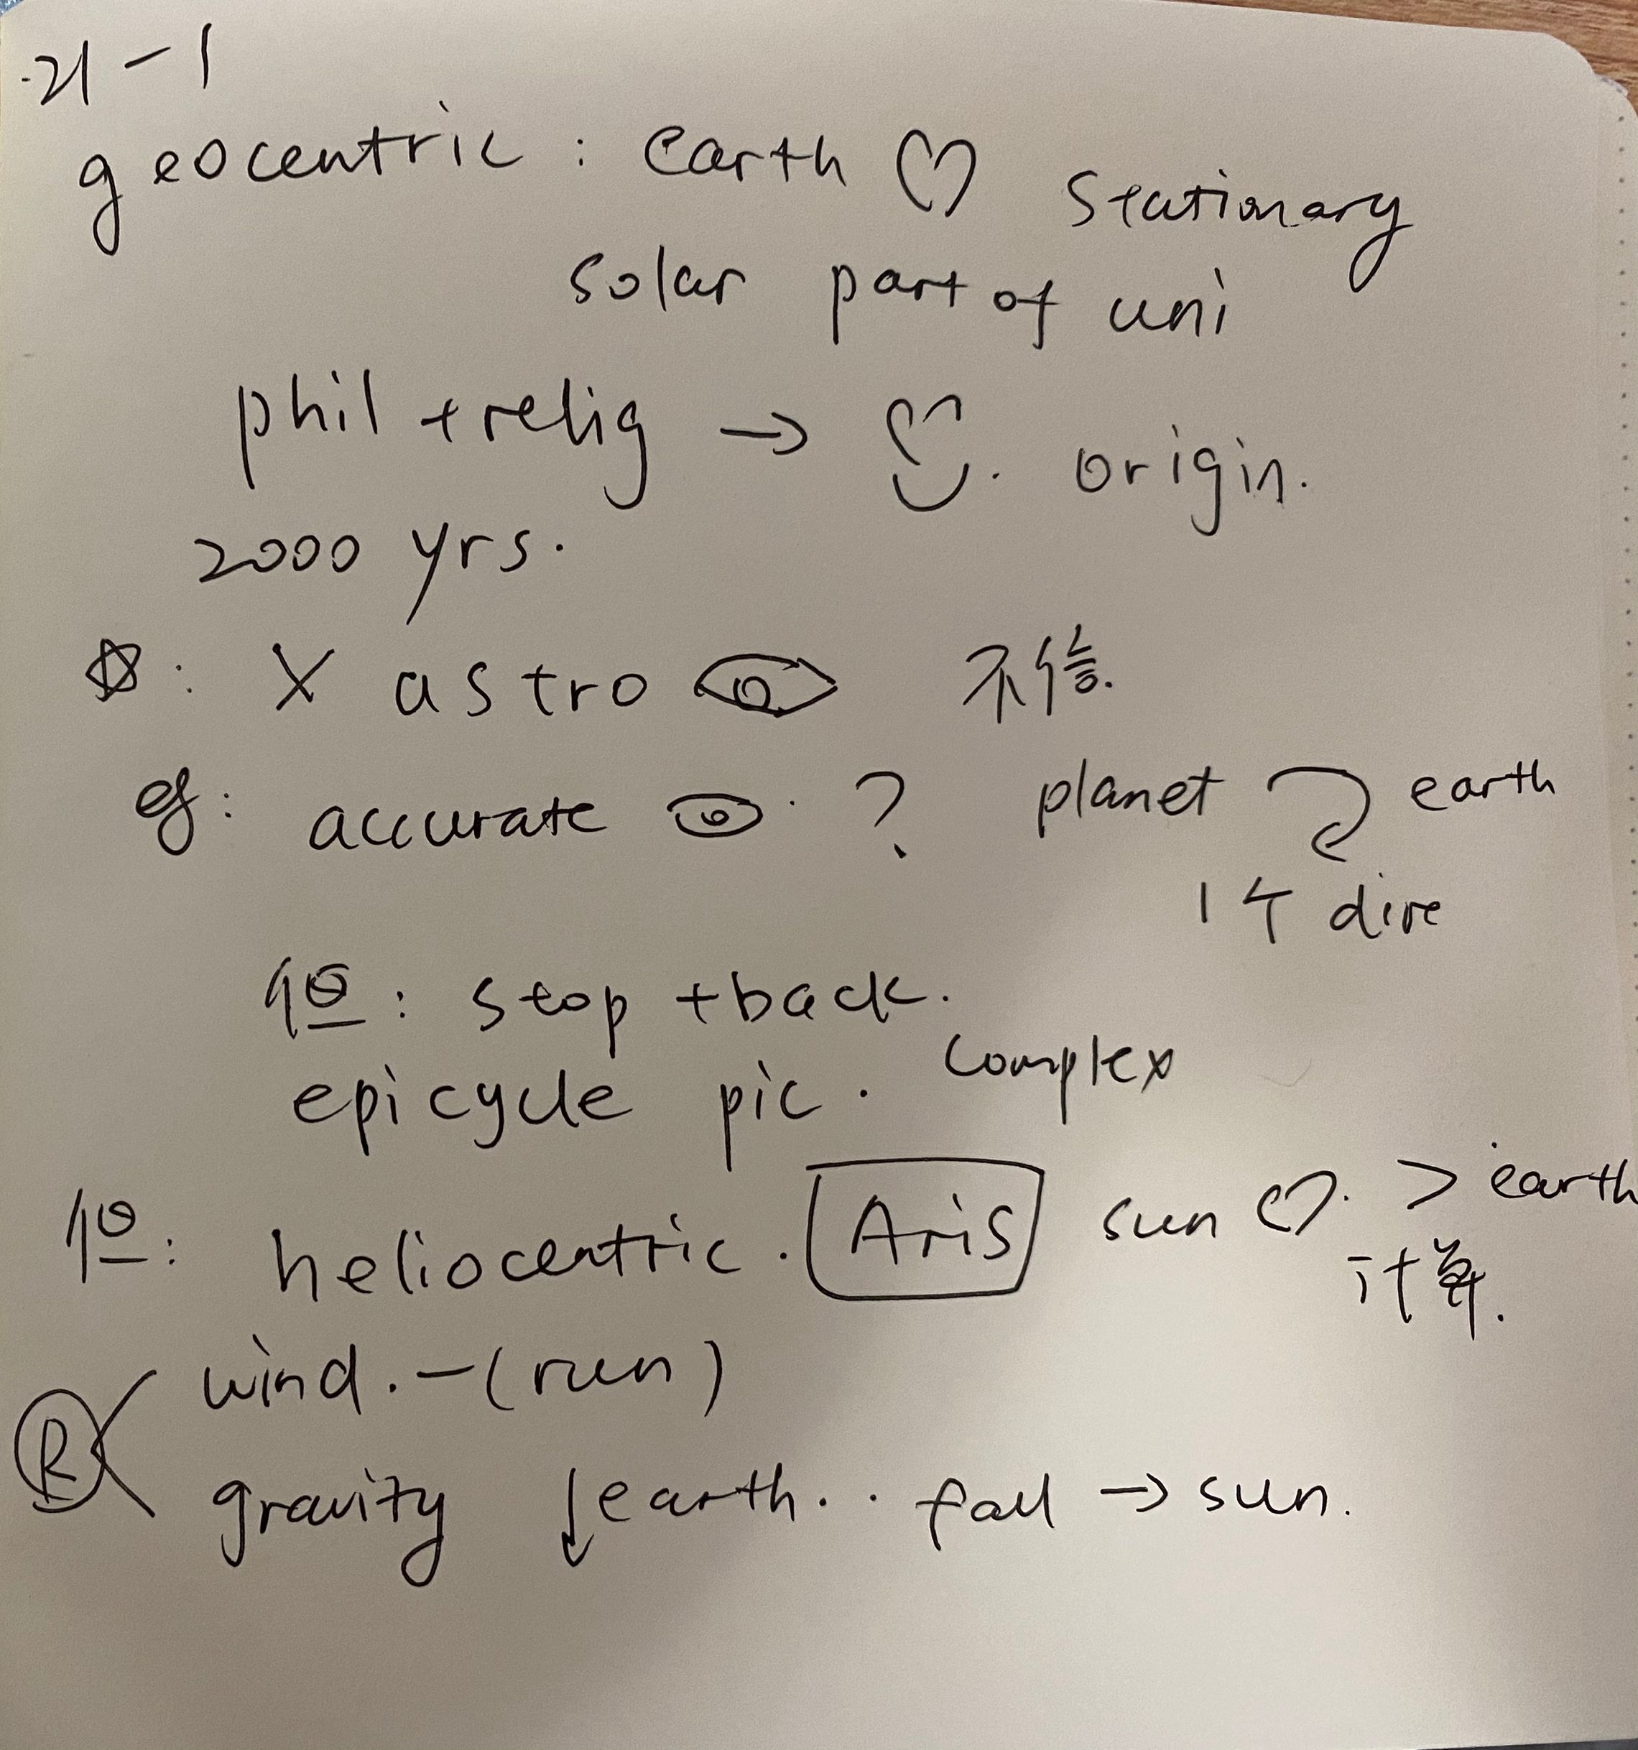
综合练习：
TPO21-L1

Slide 41
End

